Slide 2
Families Built by the Lord

Slide 3
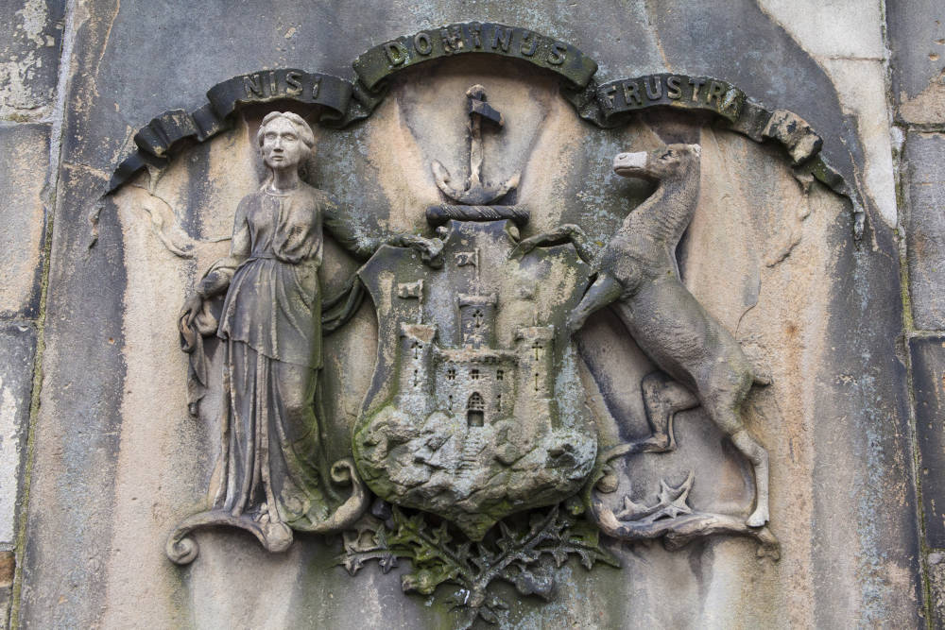
Psalm 127
Unless the LORD builds the house, They labor in vain who build it; Unless the LORD guards the city, The watchman keeps awake in vain. It is vain for you to rise up early, To retire late, To eat the bread of painful labors; For He gives to His beloved even in his sleep. Behold, children are a gift of the LORD, The fruit of the womb is a reward. Like arrows in the hand of a warrior, So are the children of one's youth. How blessed is the man whose quiver is full of them; They will not be ashamed When they speak with their enemies in the gate.

Slide 4
5 THINGS YOU MUST DO…
You MUST invite God into your home
You MUST follow His pattern
You MUST work
You MUST put His things first
You MUSTN’T get discouraged

Slide 5
5 THINGS YOU MUST DO…
You MUST invite God into your home
II Chronicles 7:1-3
¹Now when Solomon had finished praying, fire came down from heaven and consumed the burnt offering and the sacrifices, and the glory of the LORD filled the house
³All the sons of Israel, seeing the fire come down and the glory of the LORD upon the house, bowed down on the pavement with their faces to the ground, and they worshiped and gave praise to the LORD, saying, "Truly He is good, truly His lovingkindness is everlasting."
I Chronicles 29:10-19
"O LORD, the God of Abraham, Isaac and Israel, our fathers, preserve this forever in the intentions of the heart of Your people, and direct their heart to You; and give to my son Solomon a perfect heart to keep Your commandments, Your testimonies and Your statutes, and to do them all, and to build the temple, for which I have made provision."

Slide 6
5 THINGS YOU MUST DO…
You MUST follow His pattern
I Chronicles 28:19
"All this," said David, "the LORD made me understand in writing by His hand upon me, all the details of this pattern."

Slide 7
5 THINGS YOU MUST DO…
You MUST work
Nehemiah 2:18
I told them how the hand of my God had been favorable to me and also about the king's words which he had spoken to me. Then they said, "Let us arise and build." So they put their hands to the good work.
Nehemiah 4:6
So we built the wall and the whole wall was joined together to half its height, for the people had a mind to work.

Slide 8
5 THINGS YOU MUST DO…
You MUST put God’s things first
Haggai 1:4-8
"Is it time for you yourselves to dwell in your paneled houses while this house lies desolate?" Now therefore, thus says the LORD of hosts, "Consider your ways! "You have sown much, but harvest little; you eat, but there is not enough to be satisfied; you drink, but there is not enough to become drunk; you put on clothing, but no one is warm enough; and he who earns, earns wages to put into a purse with holes." Thus says the LORD of hosts, "Consider your ways! "Go up to the mountains, bring wood and rebuild the temple, that I may be pleased with it and be glorified," says the LORD.
Nehemiah 4:6
So we built the wall and the whole wall was joined together to half its height, for the people had a mind to work.

Slide 9
5 THINGS YOU MUST DO…
You MUSTN’T get discouraged
Daniel 9:8-14
"Open shame belongs to us, O Lord, to our kings, our princes and our fathers, because we have sinned against You. "To the Lord our God belong compassion and forgiveness, for we have rebelled against Him; nor have we obeyed the voice of the LORD our God, to walk in His teachings which He set before us through His servants the prophets. "Indeed all Israel has transgressed Your law and turned aside, not obeying Your voice; so the curse has been poured out on us, along with the oath which is written in the law of Moses the servant of God, for we have sinned against Him.
Nehemiah 4:6
So we built the wall and the whole wall was joined together to half its height, for the people had a mind to work.

Slide 10
5 THINGS YOU MUST DO…
You MUSTN’T get discouraged
Daniel 9:8-14
"Thus He has confirmed His words which He had spoken against us and against our rulers who ruled us, to bring on us great calamity; for under the whole heaven there has not been done anything like what was done to Jerusalem. "As it is written in the law of Moses, all this calamity has come on us; yet we have not sought the favor of the LORD our God by turning from our iniquity and giving attention to Your truth. "Therefore the LORD has kept the calamity in store and brought it on us; for the LORD our God is righteous with respect to all His deeds which He has done, but we have not obeyed His voice.
Nehemiah 4:6
So we built the wall and the whole wall was joined together to half its height, for the people had a mind to work.

Slide 11
5 THINGS YOU MUST DO…
You MUSTN’T get discouraged
I John 1:5-9
This is the message we have heard from Him and announce to you, that God is Light, and in Him there is no darkness at all. If we say that we have fellowship with Him and yet walk in the darkness, we lie and do not practice the truth; but if we walk in the Light as He Himself is in the Light, we have fellowship with one another, and the blood of Jesus His Son cleanses us from all sin. If we say that we have no sin, we are deceiving ourselves and the truth is not in us. If we confess our sins, He is faithful and righteous to forgive us our sins and to cleanse us from all unrighteousness.
Nehemiah 4:6
So we built the wall and the whole wall was joined together to half its height, for the people had a mind to work.

Slide 12
5 THINGS YOU MUST DO…
You MUSTN’T get discouraged
Galatians 6:7-9
Do not be deceived, God is not mocked; for whatever a man sows, this he will also reap. For the one who sows to his own flesh will from the flesh reap corruption, but the one who sows to the Spirit will from the Spirit reap eternal life. Let us not lose heart in doing good, for in due time we will reap if we do not grow weary.
Nehemiah 4:6
So we built the wall and the whole wall was joined together to half its height, for the people had a mind to work.

Slide 13
Families Built by the Lord

