Slide 2
CONFLICT
ANXIETY
AND
AMONG CITIZENS

Slide 3
OUR CITIZNESHIP CHANGES
THE WAY WE TREAT EACH OTHER
Philippians 4:2-3
Euodia, Syntyche,

Slide 4
OUR CITIZNESHIP CHANGES
THE WAY WE TREAT EACH OTHER
Philippians 4:2-3
Euodia, Syntyche, I beg you stop arguing…(CEV)
We are called to be peacemakers
We are people of the book of Life!

Slide 5
SO SEEK JOY!
Philippians 4:4-5
Instead of arguing…rejoice!
Show your gentle spirit
David understood how to rejoice
Psalm 13

Slide 6
DON’T BE ANXIOUS
Philippians 4:6
The Lord is near.
Psalm 145:18 “The LORD is near to al l who call upon Him, to all who call upon Him in truth.”
So PRAY, reach out to Him!

Slide 7
HAVE THE PEACE OF GOD
Philippians 4:7
Trust God to do something with your problems

Slide 8
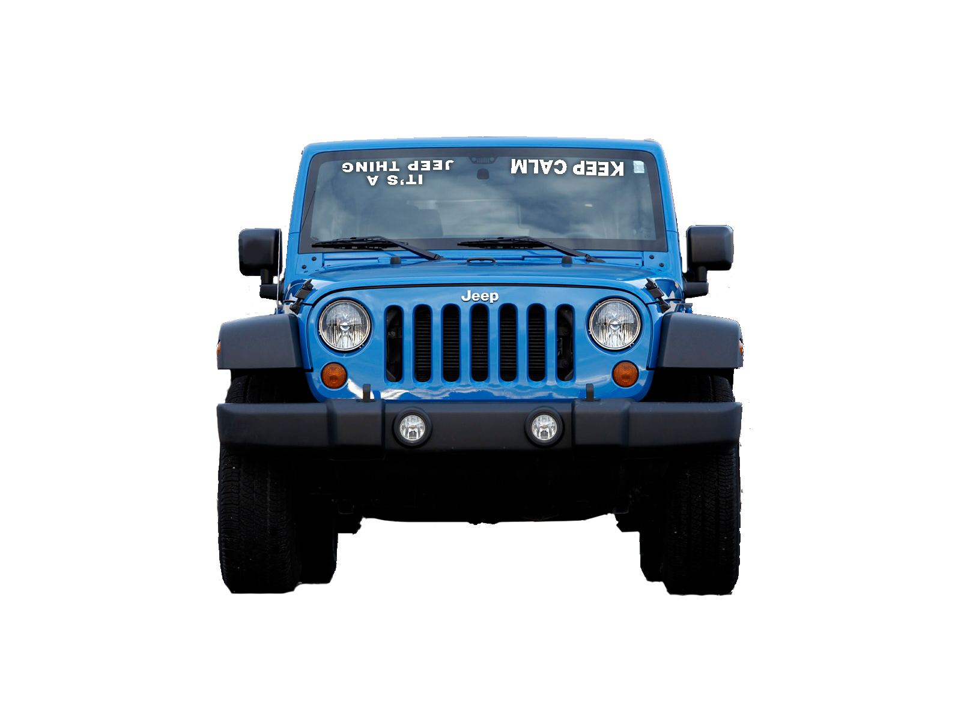
HAVE THE PEACE OF GOD
Philippians 4:7
Trust God to do something with your problems

Slide 9
HAVE THE PEACE OF GOD
Philippians 4:7
Trust God to do something with your problems

Slide 10
HAVE THE PEACE OF GOD
Philippians 4:7
Trust God to do something with your problems

Slide 11
HAVE THE PEACE OF GOD
Philippians 4:7
Trust God to do something with your problems
God doesn’t offer to explain that…He just promises it!

Slide 12
CONFLICT
ANXIETY
AND
AMONG CITIZENS

